Slide 1





Online Shopping kart
Course / Date
24SDCS02A — Feb 2025
Team
Pranavi CR-2410030233
Roopasri T-2410030033
Jyoshnasree A-2410030374
Jaideep-2410030100
Himadhar Varma-2410030086

Slide 2



NEXT SLIDE
Introduction – Why This Project Matters
Online Shopping Kart is a full-stack e-commerce web application that provides a seamless online shopping experience for users. The platform allows users to browse products, add items to their cart, and place orders efficiently. It includes secure authentication using Google Sign-In to ensure user safety. A unique feature of this project is the AI-powered virtual try-on system, which enables users to visualize how clothing items would look on them before making a purchase.
01

Slide 3

NEXT SLIDE
Objectives
To develop a full-stack e-commerce web application
To implement secure user authentication using Google Sign-In
To design product browsing, cart, and wishlist functionalities
To enable smooth checkout and order management system
To integrate an AI-powered virtual try-on feature
To provide a seamless and user-friendly shopping experience
02

Slide 4
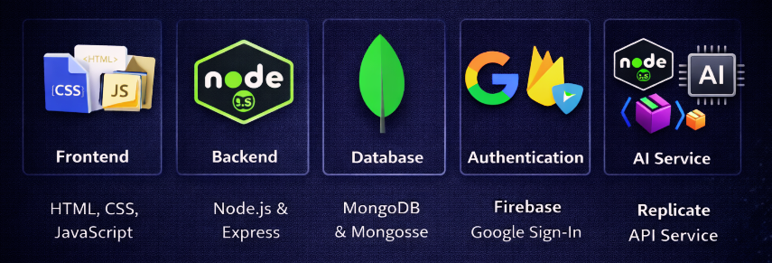

NEXT SLIDE
Tech Stack
03

Slide 5

NEXT SLIDE
Features Overview
Authentication Module - Secure login using Firebase Google Sign-In and guest access
Cart & Wishlist - Add, remove, and manage products with quantity updates
Checkout System - Multi-step process including address, payment, and order confirmation
Order Management - Store and retrieve user orders with tracking functionality
Discount & Offers - Smart discount system where offers vary to make shopping more engaging and beneficial
Delivery Date Selection - Allows users to choose their preferred delivery date for receiving the product
04

Slide 6
NEXT SLIDE
AI Virtual Try-On
Allows users to upload their photo
Users can select a clothing item
System combines user image and product image
Uses AI model (Replicate) for processing
Generates a realistic try-on output image
Helps users visualize products before purchase
05

Slide 7
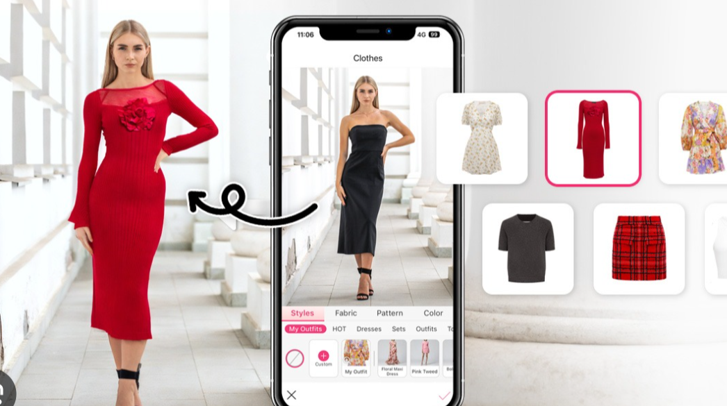
NEXT SLIDE
06

Slide 8
NEXT SLIDE
Backend APIs
/api/auth/login - Handles user authentication using Firebase UID
/api/product/all - Retrieves all available products
/api/product/:id - Fetches details of a specific product
/api/order/create - Creates a new order in the database
/api/order/user/:userId - Retrieves all orders of a user
/api/tryon - Processes AI virtual try-on and returns generated image
07

Slide 9
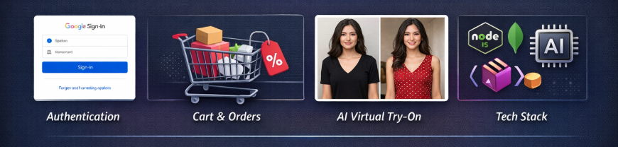
NEXT SLIDE
System Architecture
The system follows a client-server architecture where the frontend communicates with the backend through APIs. The backend processes requests, interacts with the database, and also connects with the AI service for the virtual try-on feature.
08

Slide 10
thank you

